Slide 1
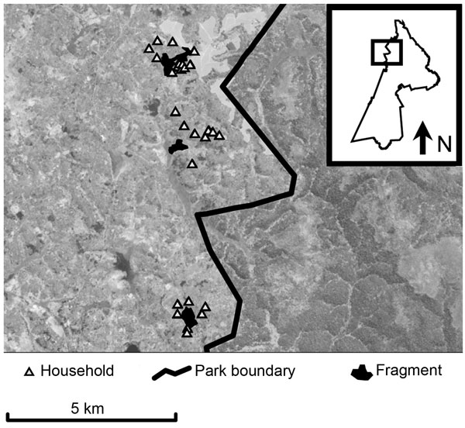
Figure 1
Figure 1.&nbsp;Map of study area within Kibale National Park, western Uganda (box) and forest fragments and households included in the study. Fragments are (from north to south) Kiko 1, Bugembe, Rurama (see Table 1 for details). Households, park boundary, and fragments are superimposed on a Landsat satellite image (30-m resolution).
Goldberg TL, Gillespie TR, Rwego IB, Estoff EL, Chapman CA. Forest Fragmentation as Cause of Bacterial Transmission among Nonhuman Primates, Humans, and Livestock, Uganda. Emerg Infect Dis. 2008;14(9):1375-1382. https://doi.org/10.3201/eid1409.071196

