Slide 1
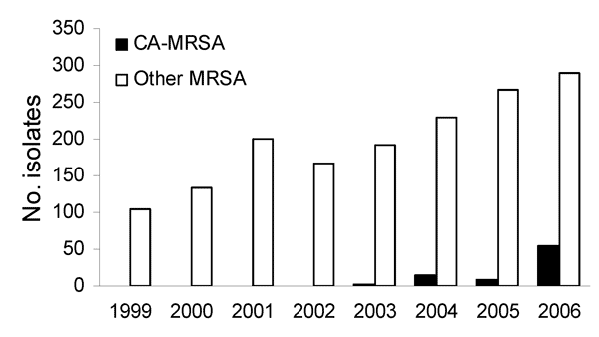
Figure 1
Figure 1. . . . Number of invasive methicillin-resistant Staphylococcus aureus isolates submitted in Iowa, USA, 1999–2006. CA-MRSA, community-associated MRSA.
Van De Griend P, Herwaldt LA, Alvis B, DeMartino M, Heilmann K, Doern G, et al. Community-Associated Methicillin-Resistant Staphylococcus aureus, Iowa, USA. Emerg Infect Dis. 2009;15(10):1582-1589. https://doi.org/10.3201/eid1510.080877

