Slide 1
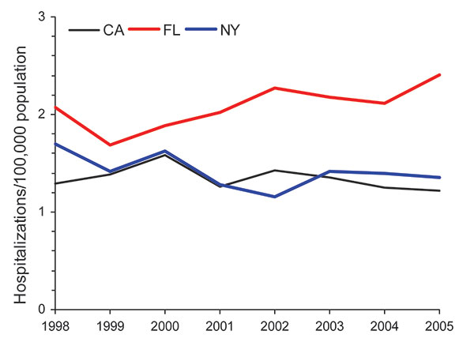
Figure 4
Figure 4.&nbsp;Age-adjusted prevalence of non-AIDS pulmonary nontuberculous mycobacteria–associated hospitalizations among men, California (CA), Florida (FL), and New York (NY), USA, Healthcare Cost and Utilization Project state inpatient databases, 1998–2005.
Billinger ME, Olivier KN, Viboud C, Montes de Oca R, Steiner CA, Holland SM, et al. Nontuberculous Mycobacteria–associated Lung Disease in Hospitalized Persons, United States, 1998–2005. Emerg Infect Dis. 2009;15(10):1562-1569. https://doi.org/10.3201/eid1510.090196

