Slide 1
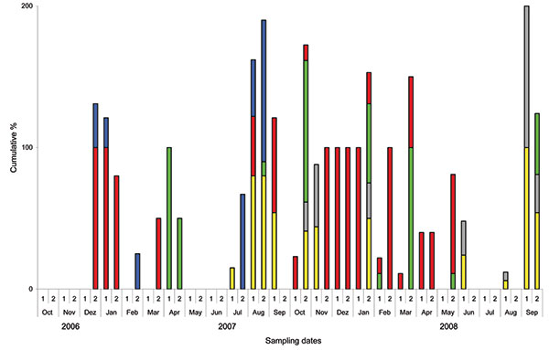
Figure 2
Figure 2.&nbsp;Months with positive results for sentinel birds over a 2-year period at 5 locations in Germany, Switzerland, and Austria. Sites at Lake Constance: Radolfzell, Germany (yellow); Bregenz-Thal, Austria (gray); and Altenrhein, Switzerland (green). Additional sentinel stations at Lake Felchow, Brandenburg, Germany (red), and Isle of Koos, Mecklenburg–Western Pomerania, Germany (blue). Bars indicate the cumulative percentage of sentinel birds tested positive at each of the 5 locations at the time of sampling (maximum 500% at all 5 stations). For example, in December 2006, all sentinel ducks at station 4, but only 30% of sentinels at station 5, were positive at the date of sampling. 1, days 1–15 of month; 2, day 16 through end of month.
Globig A, Baumer A, Revilla-Fernández S, Beer M, Wodak E, Fink M, et al. Ducks as Sentinels for Avian Influenza in Wild Birds. Emerg Infect Dis. 2009;15(10):1633-1636. https://doi.org/10.3201/eid1510.090439

