Slide 1
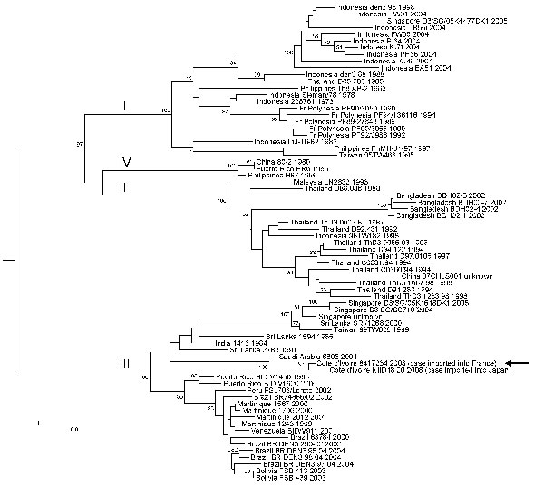
Figure
Figure.&nbsp;Phylogenetic analysis of selected dengue virus type 3 (DENV-3) sequences. The main genotypes are indicated using roman numerals at the node of the lineage. Sequence identification is as follows: country of origin, strain name, year of isolation/detection. The sequence determined in our study is underlined and designated by an arrow. Phylogenetic studies were conducted by using MEGA version 2.1 (5). Genetic distances were calculated with the Kimura 2-parameter method at the nucleotide level. Phylogenetic trees were constructed using the neighbor-joining method. The robustness of the nodes was tested by 500 bootstrap replications. The tree was rooted with DENV-1, DENV-2, and DENV-4 sequences. Scale bar indicates nucleotide substitutions per site.
Ninove L, Parola P, Baronti C, de Lamballerie X, Gautret P, Doudier B, et al. Dengue Virus Type 3 Infection in Traveler Returning from West Africa. Emerg Infect Dis. 2009;15(11):1871-1872. https://doi.org/10.3201/eid1511.081736

