Slide 1
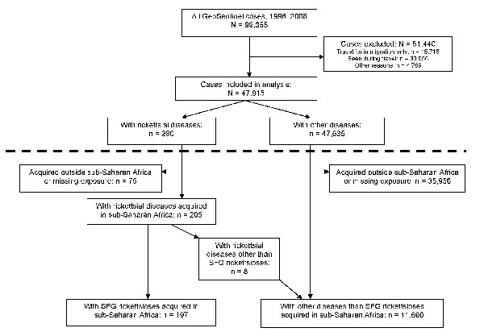
Figure 1
Figure 1.&nbsp;Study design with main study (above dotted line) and substudy (below dotted line) of spotted fever group (SFG) rickettsiosis acquired in sub-Saharan Africa, 1996–2008.
Jensenius M, Davis X, von Sonnenburg F, Schwartz E, Keystone JS, Leder K, et al. Multicenter GeoSentinel Analysis of Rickettsial Diseases in International Travelers, 1996–2008. Emerg Infect Dis. 2009;15(11):1791-1798. https://doi.org/10.3201/eid1511.090677

