Slide 1
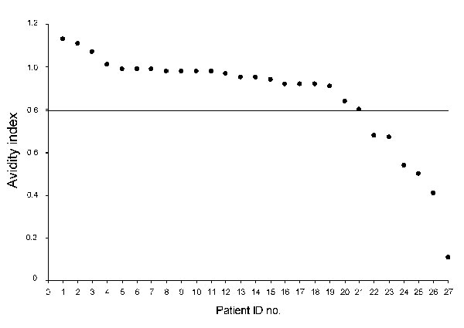
Figure
Figure.&nbsp;Antibody avidity indices for 27 HIV-infected migrants, Italy, 2004–2007. Horizontal line indicates the cutoff value. ID, identification.
Pezzoli MC, El Hamad I, Scarcella C, Vassallo F, Speziani F, Cristini G, et al. HIV Infection among Illegal Migrants, Italy, 2004–2007. Emerg Infect Dis. 2009;15(11):1802-1804. https://doi.org/10.3201/eid1511.090908

