Slide 1
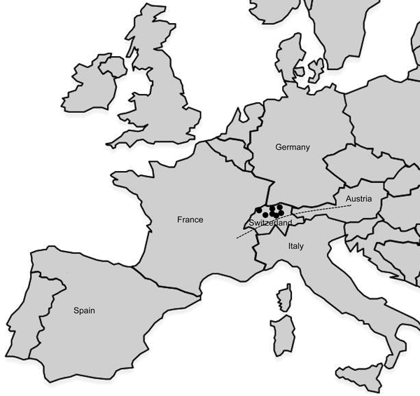
Figure 2
Figure 2.&nbsp;Geographic distribution of Francisella tularensis subsp. holarctica strains of the central and western European genetic cluster isolated in Switzerland. Dots represent the geographic origin of the isolates (from 7 Swiss cantons). The dashed line indicates the Alps. Strains of the subclade B.Br:FTNF002–00 are known to be present in France and Spain.
Pilo P, Johansson A, Frey J. Identification of Francisella tularensis Cluster in Central and Western Europe. Emerg Infect Dis. 2009;15(12):2049-2051. https://doi.org/10.3201/eid1512.080805

