Slide 1
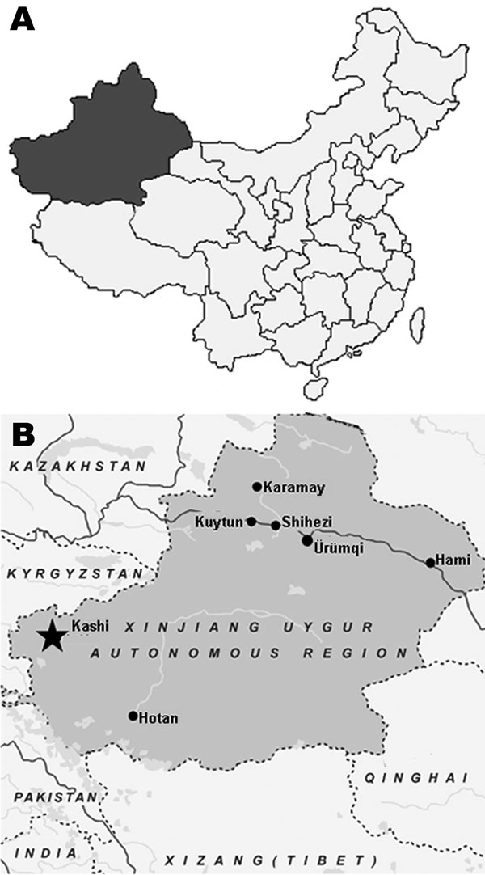
Figure 1
Figure 1.&nbsp;A) Map of China showing location of Xinjiang Uygur Autonomous Region. B) Map of Xinjiang Uygur Autonomous Region showing Kashi region (star), where Tahyna virus XJ0625 was isolated from a pool of Culex spp. mosquitoes.
Lu Z, Lu X, Fu S, Zhang S, Li Z, Yao X, et al. Tahyna Virus and Human Infection, China. Emerg Infect Dis. 2009;15(2):306-309. https://doi.org/10.3201/eid1502.080722

