Slide 1
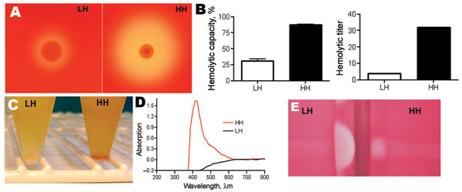
Figure 1
Figure 1.&nbsp;A) Hemolytic zone on blood agar plate after 48 h: Low hemolytic (LH) colony and high hemolytic (HH) colony. B) Hemolytic activity of the pigment extract presented as hemolytic capacity (left graph) relative to that of sodium dodecyl sulfate (100%) and as hemolytic titer (right graph) evaluated with a microdilution assay. Error bars indicate SEM. C) Phenotypic appearance of group B streptococci after overnight culture in Todd-Hewitt broth plus 1.5% yeast extract, displaying a white pellet (LH) and an orange pellet (HH). D) Absorbance profile of the pigment extract. E) Results of CAMP testing, which display a stronger reaction with the LH than with the HH phenotype.
Sendi P, Johansson L, Dahesh S, Van Sorge NM, Darenberg J, Norgren M, et al. Bacterial Phenotype Variants in Group B Streptococcal Toxic Shock Syndrome. Emerg Infect Dis. 2009;15(2):223-232. https://doi.org/10.3201/eid1502.080990

