Slide 1
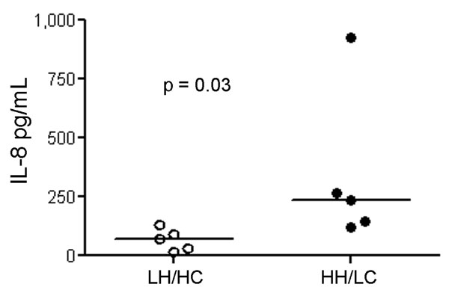
Figure 5
Figure 5.&nbsp;Interleukin (IL)– 8 induction in human peripheral blood mononuclear cells (PBMCs) (n = 5) using live bacteria. IL-8 concentration measured in cell culture supernatants of PBMCs were after exposure to live high hemolytic (HH)/low encapsulation (LC) and low hemolytic (LH)/high encapsulation (HC) bacteria. Horizontal lines indicate the median.
Sendi P, Johansson L, Dahesh S, Van Sorge NM, Darenberg J, Norgren M, et al. Bacterial Phenotype Variants in Group B Streptococcal Toxic Shock Syndrome. Emerg Infect Dis. 2009;15(2):223-232. https://doi.org/10.3201/eid1502.080990

