Slide 1
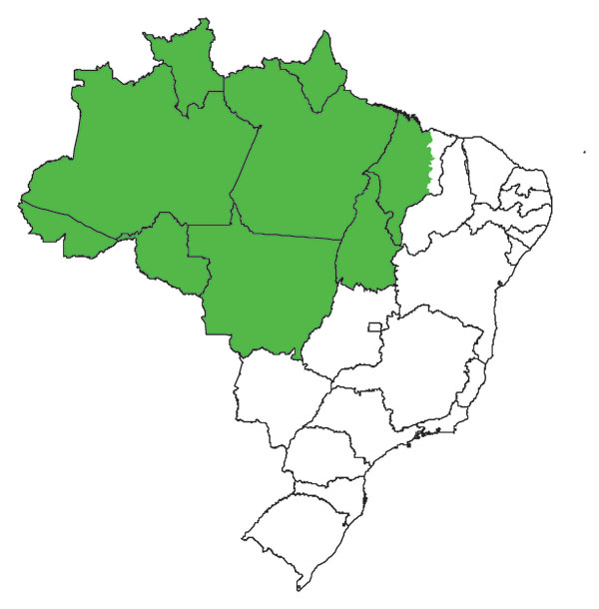
Figure 1
Figure 1.&nbsp;Map of Brazil showing the Amazon region (green).
Penna G, Pinto LF, Soranz D, Glatt R. High Incidence of Diseases Endemic to the Amazon Region of Brazil, 2001–2006. Emerg Infect Dis. 2009;15(4):626-632. https://doi.org/10.3201/eid1504.081329

