Slide 1
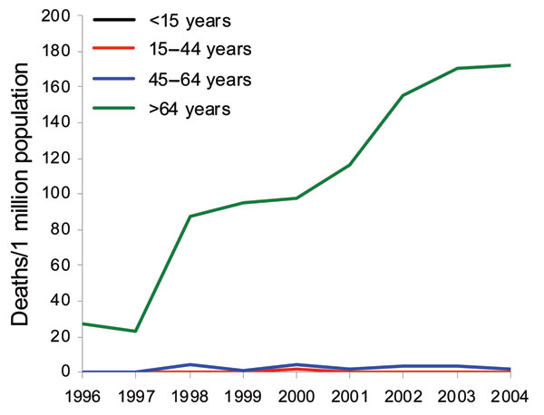
Figure 3
Figure 3.&nbsp;Mortality rates associated with Clostridium difficile, by age, 1996–2004, Finland.
Lyytikäinen O, Turunen H, Sund R, Rasinperä M, Könönen E, Ruutu P, et al. Hospitalizations and Deaths Associated with Clostridium difficile Infection, Finland, 1996–2004. Emerg Infect Dis. 2009;15(5):761-765. https://doi.org/10.3201/eid1505.081154

