Slide 1
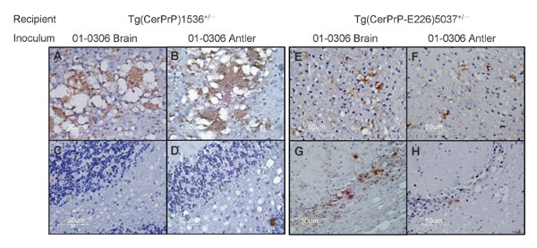
Figure 4
Figure 4.&nbsp;PrPSc (disease-associated form of prion protein)–specific immunohistochemistry in the brains of diseased mice. Transgenic (Tg) mice Tg(CerPrP)1536+/– inoculated with brain (A) and antler velvet (B) preparations from elk 01-0306 exhibit florid PrPSc-reactive plaques in the cerebral cortex at the level of the thalamus but retain integrity of cerebellar granular cells (C and D). Tg(CerPrP-E226)5037+/– mice inoculated with brain (E) and antler velvet (F) preparations from elk 01-0306 display small plaques and diffuse granular staining in the cerebral cortex, PrPSc deposition, and marked cerebellar neuronal loss (G and H).
Angers RC, Seward TS, Napier D, Green M, Hoover E, Spraker T, et al. Chronic Wasting Disease Prions in Elk Antler Velvet. Emerg Infect Dis. 2009;15(5):696-703. https://doi.org/10.3201/eid1505.081458

