Slide 1
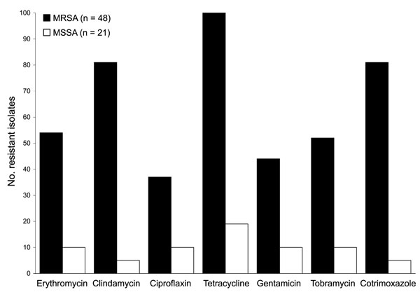
Figure 2
Figure 2.&nbsp;Antimicrobial drug susceptibility of Staphylococcus aureus strains recovered from pig farmers, Belgium, 2007. MRSA, methicillin-resistant S. aureus; MSSA, methicillin-susceptible S. aureus.
Denis O, Suetens C, Hallin M, Catry B, Ramboer I, Dispas M, et al. Methicillin-Resistant Staphylococcus aureus ST398 in Swine Farm Personnel, Belgium. Emerg Infect Dis. 2009;15(7):1098-1101. https://doi.org/10.3201/eid1507.080652

