Slide 1
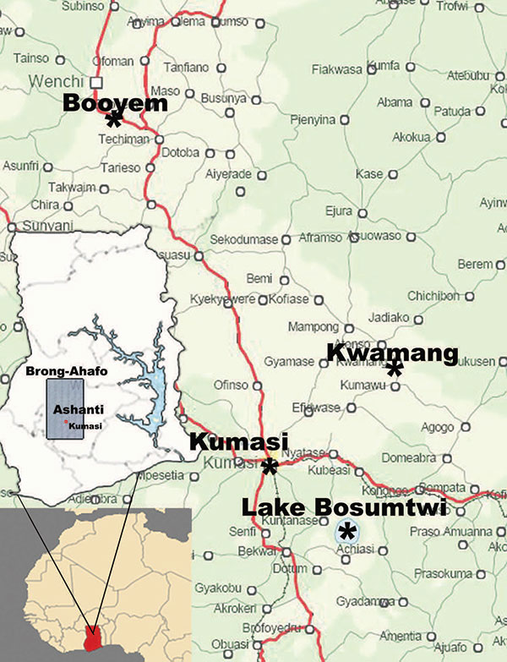
Figure 1
Figure 1.&nbsp;Location of Kwamang caves near the village of Kwamang, (6°58′N, 1°16′W), 50 km northeast of Kumasi, Ashanti region, Ghana. Booyem caves A (7°43′24.9′′N, 1°59′16.5′W) and B (7°43′25.7′′N, 1°59′33.5′′W) are located near remote small settlements in the vicinity of Booyem, Brong-Ahafo region. Lake Bosumtwi is located 30 km southeast of Kumasi (6°32′22.3′′N, 1°24′41.5′′W). The botanical gardens of Kwame Nkrumah National University of Science and Technology are located on campus in the city of Kumasi (6°41′6.4′′N, 1°33′42.8′′W). Kumasi Zoo is located in the center of the city (6°42′2.0′′N, 1°37′29.9′′W).
Pfefferle S, Oppong S, Bispo de Filippis A, Gloza-Rausch F, Ipsen A, Seebens A, et al. Distant Relatives of Severe Acute Respiratory Syndrome Coronavirus and Close Relatives of Human Coronavirus 229E in Bats, Ghana. Emerg Infect Dis. 2009;15(9):1377-1384. https://doi.org/10.3201/eid1509.090224

