Slide 1
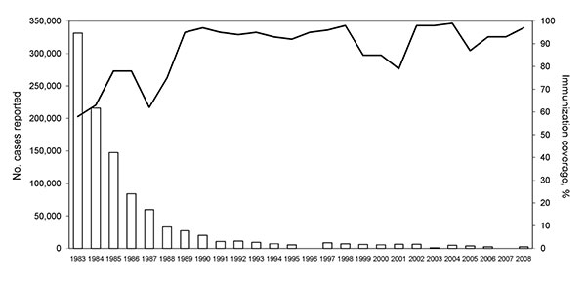
Figure 1
Figure 1.&nbsp;Number of reported pertussis cases and pertussis vaccination coverage in China, 1983–2008 (12). Although vaccination coverage increased with time, it was low before the 1980s and only 58% in 1983.
Zhang L, Xu Y, Zhao J, Kallonen T, Cui S, Xu Y, et al. Effect of Vaccination on Bordetella pertussis Strains, China. Emerg Infect Dis. 2010;16(11):1695-1701. https://doi.org/10.3201/eid1611.100401

