Slide 1
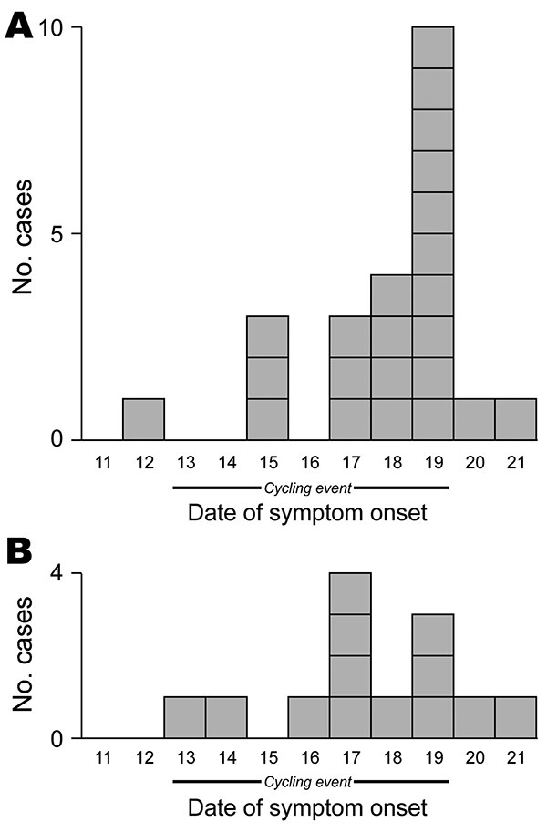
Figure 2
Figure 2.&nbsp;Comparison of epidemic curves in Internet-based survey (n = 23) (A) and telephone-based survey (n = 13) (B) for ill participants in September 2009 bicycle ride, Oregon, USA.
Oh JY, Bancroft JE, Cunningham MC, Keene WE, Lyss SB, Cieslak PR, et al. Comparison of Survey Methods in Norovirus Outbreak Investigation, Oregon, USA, 2009. Emerg Infect Dis. 2010;16(11):1773-1776. https://doi.org/10.3201/eid1611.100561

