Slide 1
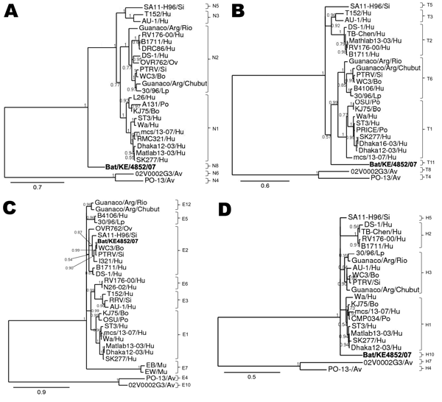
Figure 4
Figure 4.&nbsp;Phylograms indicating genetic relationships of partial or complete nucleotide sequences of A) nonstructural protein 2 (NSP2), B) NSP3, C) NSP4, and D) NSP5 of bat rotavirus strain Bat/KE4852/07 (boldface) from Kenya with representatives of known human and animal rotavirus genotypes. Posterior probability values are indicated at each branch node. Scale bars indicate nucleotide substitutions per site. GenBank accession numbers of all strains used are listed in the Technical Appendix. Genotypes of each gene segment characterized in this study are listed to the right of each tree. Si, simian; Hu, human; Ov, ovine; Bo, bovine; Lp, lapine; PO, porcine; Av, avian; Mu, murine.
Esona MD, Mijatovic-Rustempasic S, Conrardy C, Tong S, Kuzmin IV, Agwanda B, et al. Reassortant Group A Rotavirus from Straw-colored Fruit Bat (Eidolon helvum). Emerg Infect Dis. 2010;16(12):1844-1852. https://doi.org/10.3201/eid1612.101089

