Slide 1
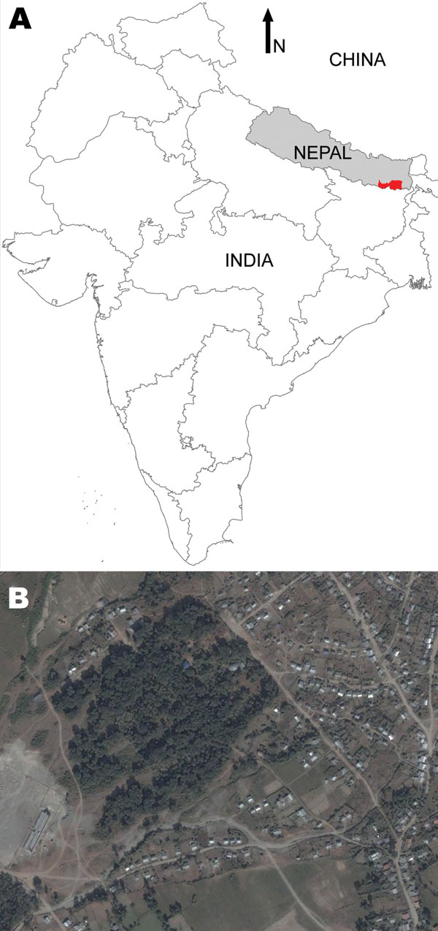
Figure 1
Figure 1.&nbsp;A) Visceral leishmaniasis–endemic area (red) of Nepal under study by KALANET project (www.kalanetproject.org); B) satellite picture of Dharan-17, Nepal. Copyrights 2009 Google Image; 2009 DigitalGlobe; 2009 Europa Technologies; and 2009 Mapabc.com.
Bhattarai NR, Van der Auwera G, Rijal S, Picado A, Speybroeck N, Khanal B, et al. Domestic Animals and Epidemiology of Visceral Leishmaniasis, Nepal. Emerg Infect Dis. 2010;16(2):231-237. https://doi.org/10.3201/eid1602.090623

