Slide 1
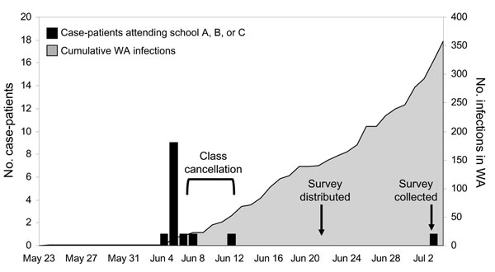
Figure 1
Figure 1.&nbsp;Confirmed pandemic (H1N1) 2009 influenza infections in Western Australia (WA), by onset date, May 23–July 4, 2009.
Effler PV, Carcione D, Giele C, Dowse GK, Goggin L, Mak DB. Household Responses to Pandemic (H1N1) 2009–related School Closures, Perth, Western Australia. Emerg Infect Dis. 2010;16(2):205-211. https://doi.org/10.3201/eid1602.091372

