Slide 1
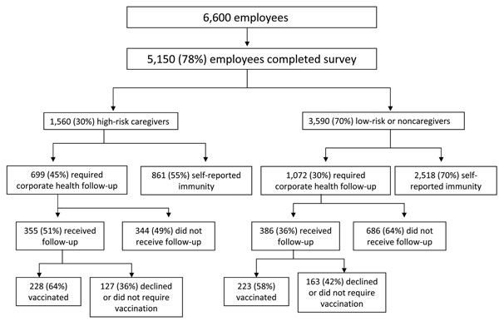
Figure 4
Figure 4.&nbsp;Survey results of self-reported mumps immunity among workforce, Northwestern Memorial Hospital, Chicago, Illinois, USA, 2006. Results are categorized by high-risk caregivers, those who worked in areas where mumps cases were located or worked with pregnant or immunosuppressed patient populations; low-risk caregivers, those who cared for patients in other inpatient or outpatient areas; or noncaregivers. Compliance with corporate health evaluation and vaccination for those who did not report immunity are also shown.
Bonebrake AL, Silkaitis C, Monga G, Galat A, Anderson J, Trad JT, et al. Effects of Mumps Outbreak in Hospital, Chicago, Illinois, USA, 2006. Emerg Infect Dis. 2010;16(3):426-432. https://doi.org/10.3201/eid1603.090198

