Slide 1
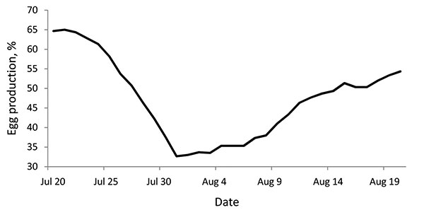
Figure 1
Figure 1.&nbsp;Average egg production of 3 pandemic (H1N1) 2009–infected turkey flocks (A1, A2, and A3) during July 20–August 20, 2009, Valparaiso, Chile. Production was calculated as a daily egg-laying rate (%).
Mathieu C, Moreno V, Retamal P, Gonzalez A, Rivera A, Fuller J, et al. Pandemic (H1N1) 2009 in Breeding Turkeys, Valparaiso, Chile. Emerg Infect Dis. 2010;16(4):709-711. https://doi.org/10.3201/eid1604.091402

