Slide 1
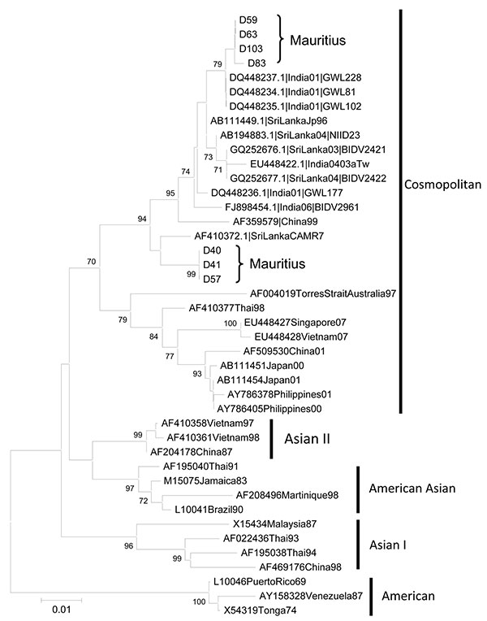
Figure
Figure.&nbsp;Phylogenetic relationships of dengue virus isolates from Mauritius inferred by envelope (E) gene sequence by using the maximum likelihood method as implemented in PAUP* version 4.0b10 (http://paup.csit.fsu.edu/about.html). Primers used for amplification of product for sequencing were 5′-AATCCAGATGTCATCAGGAAAC-3′ and 5′-CCTATAGATGTGAACACTCCTCC-3′. The E gene sequences were consolidated from overlapping, bidirectional sequences. Scale bar indicates nucleotide substitutions per site.
Issack MI, Pursem VN, Barkham TM, Ng L, Inoue M, Manraj SS. Reemergence of Dengue in Mauritius. Emerg Infect Dis. 2010;16(4):716-718. https://doi.org/10.3201/eid1604.091582

