Slide 1
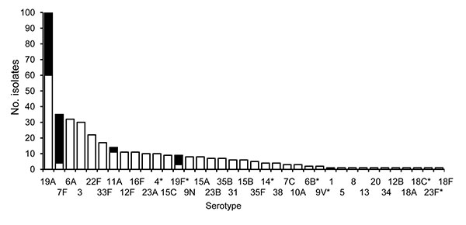
Figure 1
Figure 1.&nbsp;Frequency of pilus islet 2 (PI-2)–containing Streptococcus pneumoniae invasive isolates in metropolitan Atlanta, Georgia, USA, 2006. Black, PI-2–containing isolates; white, PI-2–lacking isolates. *Serotypes included in the 7-valent pneumococcal conjugate vaccine.
Zähner D, Gudlavalleti A, Stephens DS. Increase in Pilus Islet 2–encoded Pili among Streptococcus pneumoniae Isolates, Atlanta, Georgia, USA. Emerg Infect Dis. 2010;16(6):955-962. https://doi.org/10.3201/eid1606.091820

