Slide 1
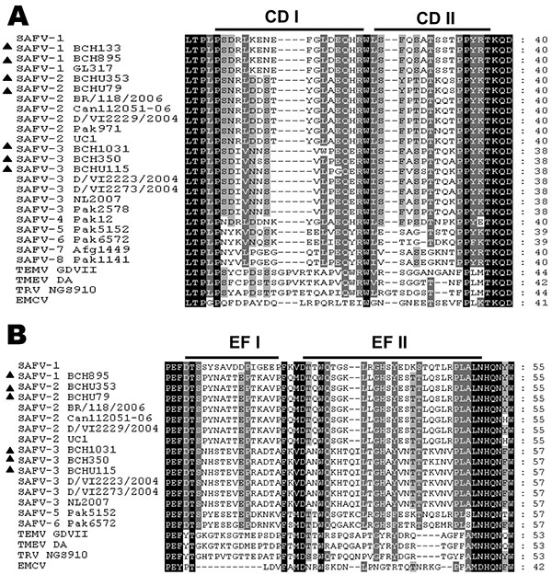
Figure 2
Figure 2.&nbsp;Alignment of Saffold cardiovirus (SAFV) viral protein (VP) 1 CD (A) and VP2 EF (B) loop sequences from strains isolated in Beijing, China, 2007–2009. Columns highlighted in black show absolute amino acid conservation; those highlighted in gray show amino acids with highly similar properties. Strains identified in this study are labeled with dark triangles (BCH133, BCH1031, BCHU115, BCH350, BCH895, BCHU353 and BCHU79) (GenBank accession nos. GU126461, GU943513–GU943518), SAFV-1 (prototype), SAFV-1 GL317, SAFV-2 Can112051-06, SAFV-2 BR/118/2006, SAFV-2 D/VI/2229/2004, SAFV-2 Pak971, SAFV-2 UC1, SAFV-3 Pak2578, SAFV-3 D/VI/2223/2004, SAFV-3 D/VI/2273/2004, SAFV-3 NL2007, SAFV-4 Pak12, SAFV-5 Pak5152, SAFV-6 Pak 6572, SAFV-7 Afg1449, SAFV-8 Pak1141, Theiler-like virus NGS910, TMEV GDVII, and EMCV were used as reference sequences (GenBank accession nos. NC009448, FJ464767, AM922293, EU681177, EU681176, FJ463601, NC010810, FJ463605, EU681179, EU681178, FM207487, FJ463600, FJ463616, FJ463617, FJ463602, FJ463604, AB090161, X56019, X87335).
Ren L, Gonzalez R, Xie Z, Xiao Y, Li Y, Liu C, et al. Saffold Cardioviruses of 3 Lineages in Children with Respiratory Tract Infections, Beijing, China. Emerg Infect Dis. 2010;16(7):1158-1161. https://doi.org/10.3201/eid1607.091682

