Slide 1
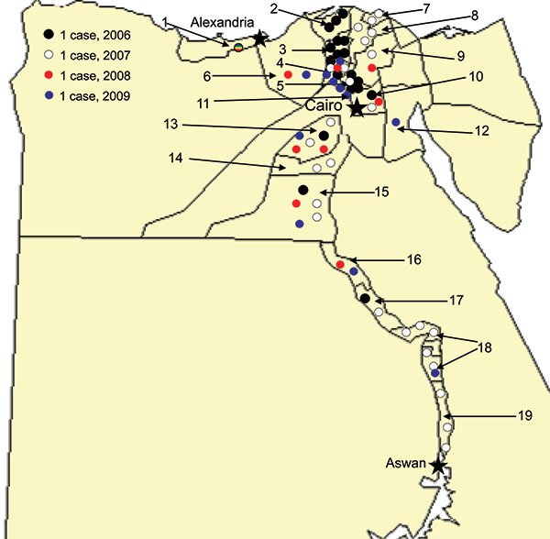
Figure 1
Figure 1.&nbsp;Residences of 63 case-patients with avian influenza virus (H5N1) infections, Egypt, 2006–2009. 1, Alexandria; 2, Kafr El Sheikh; 3, Gharbia; 4, Menofia; 5, Qalubiya; 6, Behera; 7, Damietta; 8, Dakahlia; 9, Sharkia; 10, Cairo; 11, 6th of October; 12, Suez; 13, Fayoum; 14, Benu Suef; 15, Menia; 16, Assyut; 17, Sohag; 18, Qena; 19, Aswan.
Kandeel A, Manoncourt S, el Kareem EA, Ahmed AM, El-Refaie S, Essmat H, et al. Zoonotic Transmission of Avian Influenza Virus (H5N1), Egypt, 2006–2009. Emerg Infect Dis. 2010;16(7):1101-1107. https://doi.org/10.3201/eid1607.091695

