Slide 1
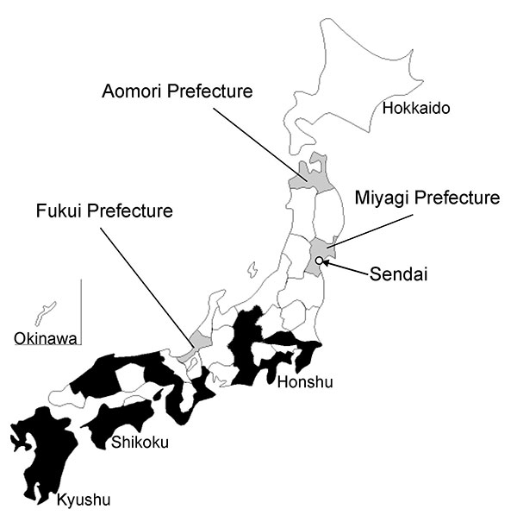
Figure 2
Figure 2.&nbsp;Distribution of reported Japanese spotted fever cases in Japan (≈2008). Prefectures in which Japanese spotted fever cases were reported up to 2008 are shown in black; Fukui, Aomori, and Miyagi prefectures are shown in gray. The map was drawn by using data on reported infectious diseases in Japan (http://idsc.nih.go.jp/idwr/pdf-j.html).
Takajo I, Kurosawa M, Sakata A, Fujita H, Sakai K, Sekine M, et al. Human Rickettsia heilongjiangensis Infection, Japan. Emerg Infect Dis. 2010;16(8):1306-1308. https://doi.org/10.3201/eid1608.100049

