Slide 1
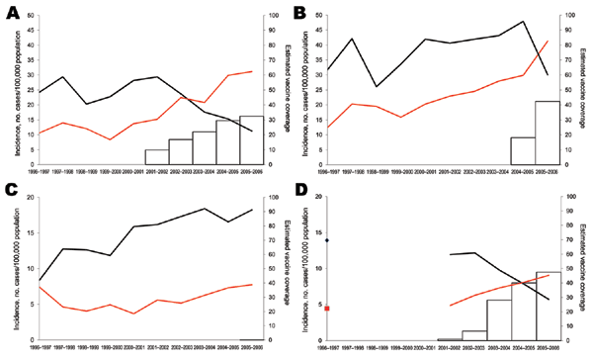
Figure 1
Figure 1.&nbsp;Incidence of pediatric invasive pneumococcal disease among children &lt;5 years of age, by heptavalent pneumococcal conjugate vaccine (PCV7) (black lines) and non-PCV7 (red lines) serotypes, for A) Spain, B) Belgium, C) England and Wales, and D) France, 1996–2006. Estimated vaccine coverage is the annual number of PCV7 schedules per 100 children &lt;2 years of age, assuming an average of 3 doses administered to each child. Vaccine coverage is not visible for England and Wales because it remains &lt;1%.
Hanquet G, Kissling E, Fenoll A, George RC, Lepoutre A, Lernout T, et al. Pediatric Pneumococcal Serotypes in 4 European Countries. Emerg Infect Dis. 2010;16(9):1428-1439. https://doi.org/10.3201/eid1609.100102

