Slide 1
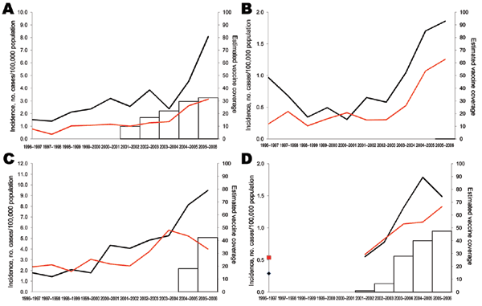
Figure 3
Figure 3.&nbsp;Incidence of invasive pneumococcal disease in children caused by serotype 1 for children &lt;5 years of age (black lines) and 5–14 years of age (red lines), in A) Spain, B) Belgium, C) England and Wales, and D) France, 1996–2006. Estimated vaccine coverage is the annual number of PCV7 schedules per 100 children &lt;2 years of age, assuming an average of 3 doses administered to each child. Vaccine coverage is not visible for England and Wales because it remains &lt;1%.
Hanquet G, Kissling E, Fenoll A, George RC, Lepoutre A, Lernout T, et al. Pediatric Pneumococcal Serotypes in 4 European Countries. Emerg Infect Dis. 2010;16(9):1428-1439. https://doi.org/10.3201/eid1609.100102

