Slide 1
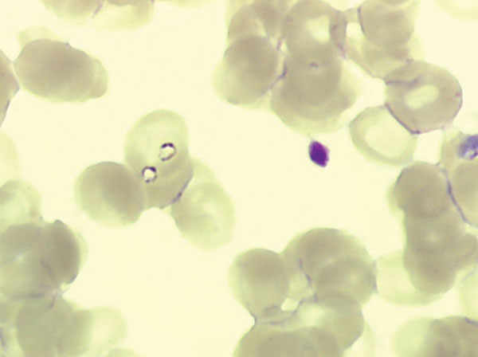
Figure 2
Figure 2.&nbsp;Two trophozoites of Babesia spp. in 1 erythrocyte from case-patient 2 (original magnification ×1,000, May-Grünwald-Giemsa stain).
Martinot M, Zadeh MM, Hansmann Y, Grawey I, Christmann D, Aguillon S, et al. Babesiosis in Immunocompetent Patients, Europe. Emerg Infect Dis. 2011;17(1):114-116. https://doi.org/10.3201/eid1701.100737

