Slide 1
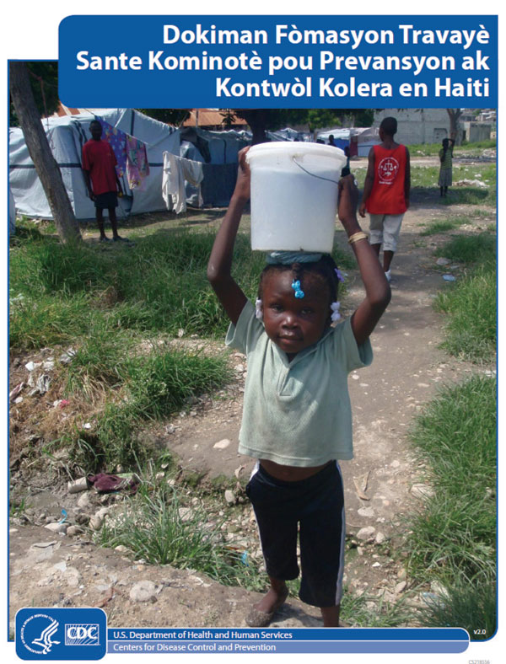
Figure 1
Figure 1.&nbsp;Cover page of community health worker cholera prevention and control training manual, Haiti, 2011.
Rajasingham A, Bowen A, O’Reilly C, Sholtes K, Schilling K, Hough C, et al. Cholera Prevention Training Materials for Community Health Workers, Haiti, 2010–2011. Emerg Infect Dis. 2011;17(11):2162-2165. https://doi.org/10.3201/eid1711.110806

