Slide 1
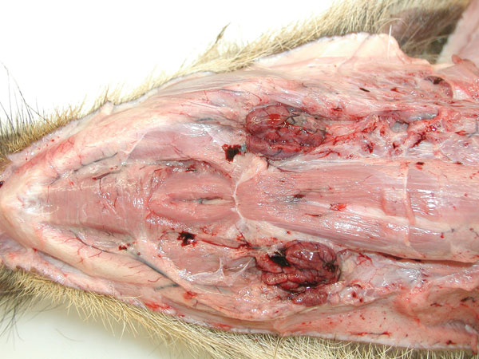
Figure 1
Figure 1.&nbsp;Ventral view of the head showing pathologic signs in a wild boar piglet after oral inoculation with 106 median tissue culture infectious dose of an African swine fever virus isolate from Armenia (experiment at the Friedrich-Loeffler-Institut). Note edematously enlarged and hemorrhagic mandibular lymph nodes. The animal died on day 7 postinfection.
Gabriel C, Blome S, Malogolovkin A, Parilov S, Kolbasov D, Teifke JP, et al. Characterization of African Swine Fever Virus Caucasus Isolate in European Wild Boars. Emerg Infect Dis. 2011;17(12):2342-2345. https://doi.org/10.3201/eid1712.110430

