Slide 1
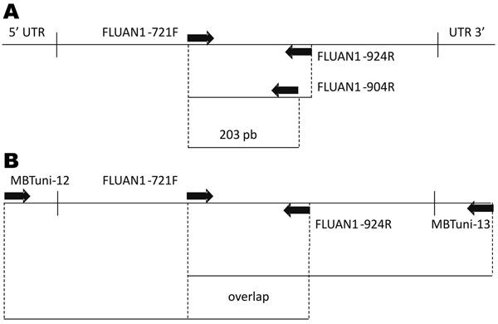
Figure 1
Figure 1.&nbsp;Reverse transcription–PCR (RT-PCR)/sequencing primers scheme for the neuraminidase (NA) gene. A) Primer position for screening RT-PCR protocol. B) Primer position and the 2 overlapping RT-PCR products for the complete NA sequence. UTR, untranslated region.
Ramirez-Gonzalez JE, Gonzalez-Duran E, Alcantara-Perez P, Wong-Arambula C, Olivera-Diaz H, Cortez-Ortiz I, et al. Oseltamivir-Resistant Pandemic (H1N1) 2009 Virus, Mexico. Emerg Infect Dis. 2011;17(2):283-286. https://doi.org/10.3201/eid1702.100897

