Slide 1
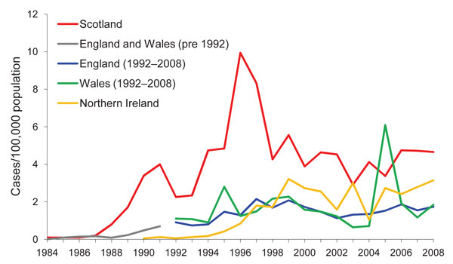
Figure 1
Figure 1.&nbsp;Rates per 100,000 population of laboratory-confirmed culture-positive Escherichia coli O157 cases, by country, United Kingdom, 1984–2008. Data outside Scotland courtesy of Health Protection Agency London, and Public Health Agency Belfast; figures for England, Wales, and Northern Ireland are verotoxin-positive cases only. Data for 2008 outside Scotland are provisional.
Locking ME, Pollock K, Allison LJ, Rae L, Hanson MF, Cowden JM. Escherichia coli O157 Infection and Secondary Spread, Scotland, 1999–2008. Emerg Infect Dis. 2011;17(3):524-527. https://doi.org/10.3201/eid1703.100167

