Slide 1
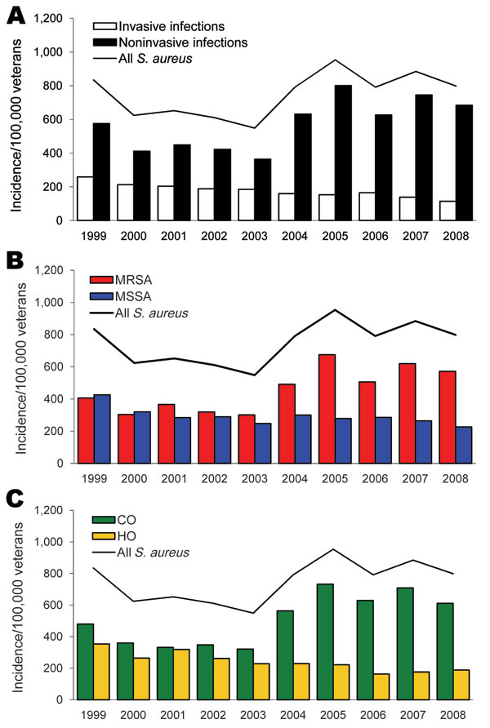
Figure 1
Figure 1.&nbsp;Incidence per 100,000 veterans of Staphylococcus aureus infections by invasive and noninvasive (A), methicillin susceptibility (B), and onset (C), Veterans Affairs Maryland Health Care System, fiscal years 1999–2008. Solid line represents all S. aureus infections. MRSA, methicillin-resistant S. aureus; MSSA, methicillin-susceptible S. aureus; CO, community onset; HO, hospital onset.
Tracy LA, Furuno JP, Harris AD, Singer M, Langenberg P, Roghmann M. Staphylococcus aureus Infections in US Veterans, Maryland, USA, 1999–2008. Emerg Infect Dis. 2011;17(3):441-448. https://doi.org/10.3201/eid1703.100502

