Slide 1
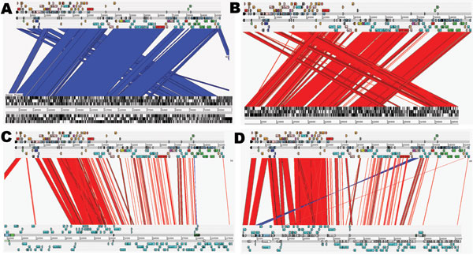
Figure 2
Figure 2.&nbsp;Artemis Comparison Tool (Sanger, Cambridge, UK) comparisons of IncK plasmid (pCT) with other plasmids. Complete DNA sequence plasmid comparisons. Bands of color indicate homology between sequences. Red lines show sequence in the same confirmation; blue lines indicate sequence inversion. The pCT sequence is represented as the top line of each comparison compared with pO26_vir (GenBank accession no. FJ38659) (A); R387 (B); R64 (accession no. AP005147) (C); and pEK204 (accession no. EU935740) (D) on each bottom line.
Cottell JL, Webber MA, Coldham NG, Taylor DL, Cerdeño-Tárraga AM, Hauser H, et al. Complete Sequence and Molecular Epidemiology of IncK Epidemic Plasmid Encoding blaCTX-M-14. Emerg Infect Dis. 2011;17(4):645-652. https://doi.org/10.3201/eid1704.101009

