Slide 1
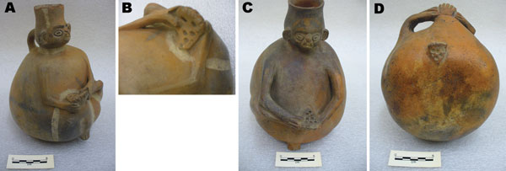
Figure 3
Figure 3.&nbsp;Two globular Chimu huacos found in Pachacamac, a sandy land area in northern Lima. Each person is examining the soles of the feet, on which multiple punch-out lesions can be detected. Panels B and D are close-up views of the feet of the huacos shown in panels A and C, respectively. Catalogs B/8853 and B/8854, courtesy of the Department of Anthropology, American Museum of Natural History.
Maco V, Tantaleán M, Gotuzzo E. Evidence of Tungiasis in Pre-Hispanic America. Emerg Infect Dis. 2011;17(5):855-862. https://doi.org/10.3201/eid1705.100542

