Slide 1
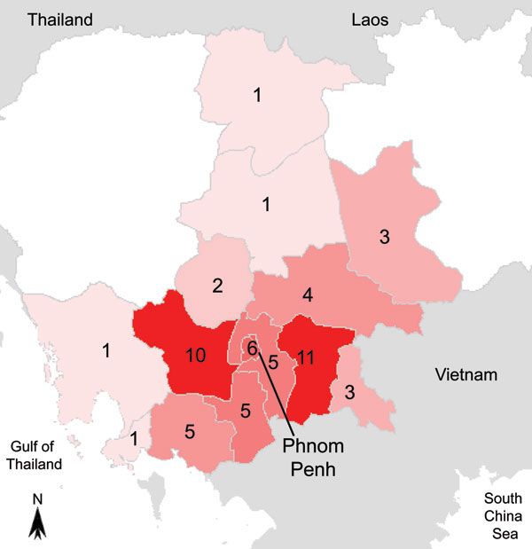
Figure 2
Figure 2.&nbsp;Map of Cambodia with geographic origin of the 58 patients with melioidosis diagnosed during July 1, 2007–January 31, 2010.
Vlieghe E, Kruy L, De Smet B, Kham C, Veng CH, Phe T, et al. Melioidosis, Phnom Penh, Cambodia. Emerg Infect Dis. 2011;17(7):1289-1292. https://doi.org/10.3201/eid1707.101069

