Slide 1
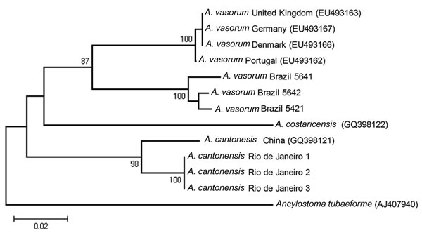
Figure
Figure.&nbsp;Neighbor-joining phylogenetic tree based on Kimura 2-parameter (K2-p) distances that includes all Angiostrongylus COI sequences in GenBank and the sequences obtained from 3 Angiostrongylus specimens recovered from the pulmonary arteries of a naturally infected Norway rat (Rattus norvegicus) from São Gonçalo, Rio de Janeiro, Brazil, 2010. The specimens yielded 1 haplotype, which clustered together with the A. cantonensis haplotype from the People’s Republic of China with a low genetic distance (K2-p 0.038). Scale bar indicates 0.02 K2-p genetic distance.
Simões RO, Monteiro FA, Sánchez E, Thiengo SC, Garcia JS, Costa-Neto SF, et al. Endemic Angiostrongyliasis, Rio de Janeiro, Brazil. Emerg Infect Dis. 2011;17(7):1331-1333. https://doi.org/10.3201/eid1707.101822

