Slide 1
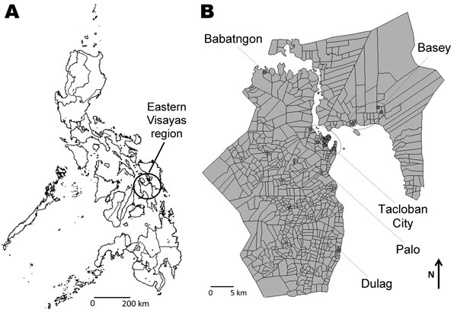
Figure 2
Figure 2.&nbsp;Geographic distribution of residences of patients in whom enterovirus 68 was detected in the Philippines, May 2008–May 2009. A) Eastern Visayas Region in the Philippines; B) expanded Eastern Visayas Region. Address information was obtained from parents of the children. Locations for 6 patients were unknown.
Imamura T, Fuji N, Suzuki A, Tamaki R, Saito M, Aniceto R, et al. Enterovirus 68 among Children with Severe Acute Respiratory Infection, the Philippines. Emerg Infect Dis. 2011;17(8):1430-1435. https://doi.org/10.3201/eid1708.101328

