Slide 1
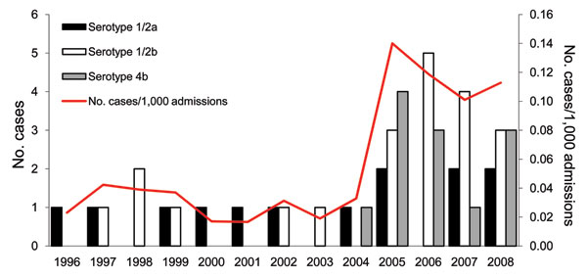
Figure 1
Figure 1.&nbsp;Incidence (cases per 1,000 admissions) of human listeriosis and serotype distribution of all isolates, National Taiwan University Hospital, Taipei, Taiwan, 1996–2008. Forty-six isolates were available for analysis, including 2 serotype 4b isolates from fetomaternal transmission in 2005 and 2006 and 1 serotype 4b from a pediatric patient (2005). Isolates from fetomaternal transmission were considered to be the same.
Huang Y, Liao C, Yang C, Teng L, Wang J, Hsueh P. Listeriosis, Taiwan, 1996–2008. Emerg Infect Dis. 2011;17(9):1731-1733. https://doi.org/10.3201/eid1709.110093

