Slide 1
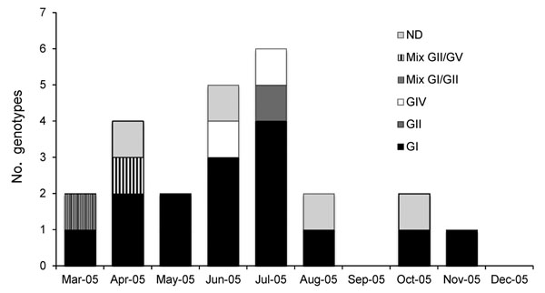
Figure 1
Figure 1. . . . Distribution of sapovirus (SaV) genotypes in children ≤5 years of age from Nicaragua, March–December 2005. A total of 16 (64%) children were infected; 4 children (16%) were infected with genogroup II (GII), and 3 (12%) were infected with GIV. SaV infections were most frequently diagnosed during June–July 2005, in the rainy period. ND, not determined
Bucardo F, Carlsson B, Nordgren J, Larson G, Blandon P, Vilchez S, et al. Susceptibility of Children to Sapovirus Infections, Nicaragua, 2005–2006. Emerg Infect Dis. 2012;18(11):1875-1878. https://doi.org/10.3201/eid1811.111581

