Slide 1
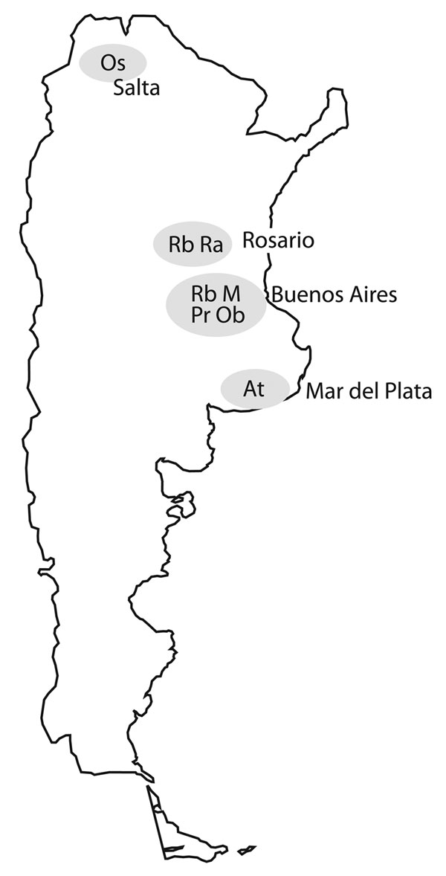
Figure 3
Figure 3. . . . Locations of 7 major multidrug-resistant tuberculosis clusters, labeled by strain type, Argentina, 2003–2009.
Ritacco V, López B, Ambroggi M, Palmero D, Salvadores B, Gravina E, et al. HIV Infection and Geographically Bound Transmission of Drug-Resistant Tuberculosis, Argentina. Emerg Infect Dis. 2012;18(11):1802-1810. https://doi.org/10.3201/eid1811.120126

