Slide 1
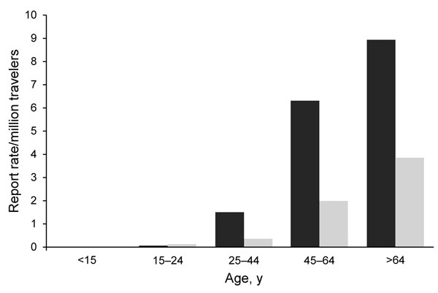
Figure 1
Figure 1. . . Notification rate of travel-associated Legionnaires’ disease (n = 607), by age group and sex, European Union/European Economic Area, 2009. Black bar, male case-patients; light gray bar, female case-patients.
Beauté J, Zucs P, de Jong B. Risk for Travel-associated Legionnaires’ Disease, Europe, 2009. Emerg Infect Dis. 2012;18(11):1811-1816. https://doi.org/10.3201/eid1811.120496

