Slide 1
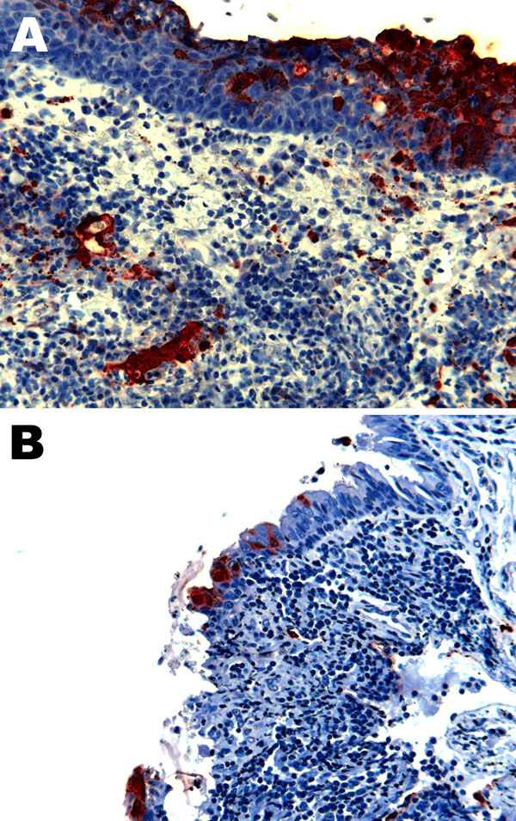
Figure 3
Figure 3. . . Nipah virus (NiV) antigen in acutely inflamed tonsillar tissue and overlying epithelium (A) and nasopharyngeal epithelium (B) in 2 ferrets infected with NiV-Bangladesh. Rabbit α-NiV N protein antiserum. Original magnification ×200.
Clayton BA, Middleton D, Bergfeld J, Haining J, Arkinstall R, Wang L, et al. Transmission Routes for Nipah Virus from Malaysia and Bangladesh. Emerg Infect Dis. 2012;18(12):1983-1993. https://doi.org/10.3201/eid1812.120875

