Slide 1
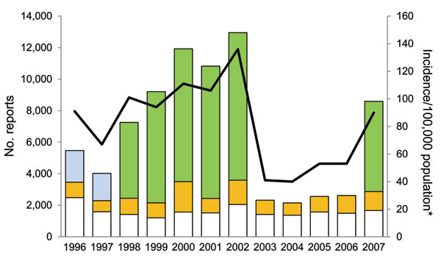
Figure 1
Figure 1.&nbsp;Number of Lyme disease surveillance reports received and incidence per 100,000 population, Connecticut, 1996–2007. White bar sections, passive surveillance; gold bar sections, active surveillance; blue bar sections, enhanced laboratory surveillance; green bar sections, mandatory laboratory surveillance; line, incidence, determined by using decennial census data encompassing the year data were reported.
Ertel S, Nelson RS, Cartter ML. Effect of Surveillance Method on Reported Characteristics of Lyme Disease, Connecticut, 1996–2007. Emerg Infect Dis. 2012;18(2):242-247. https://doi.org/10.3201/eid1802.101219

