Slide 1
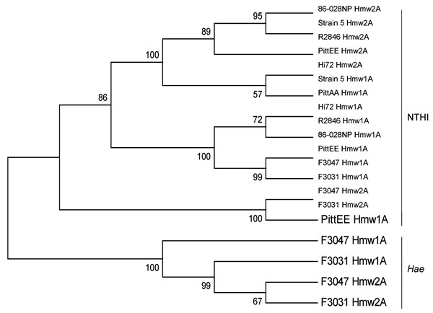
Figure 5
Figure 5.&nbsp;Phylogenetic relatedness of HmwA binding domain. Neighbor-joining tree based on the predicted binding domain of the HmwA adhesins from the indicated nontypeable Haemophilus influenzae (NTHI) strains, constructed by using MEGA5.02 (25). Bootstrap confidence values are shown at the branches, based on 1,000 replications. The population divides into 2 major clusters; HmwA alleles from nontypeable H. influenzae strains are clearly separated from H. influenzae biogroup aegyptius (Hae).
Strouts FR, Power P, Croucher NJ, Corton N, van Tonder A, Quail MA, et al. Lineage-specific Virulence Determinants of Haemophilus influenzae Biogroup aegyptius. Emerg Infect Dis. 2012;18(3):449-457. https://doi.org/10.3201/eid1803.110728

