Slide 1
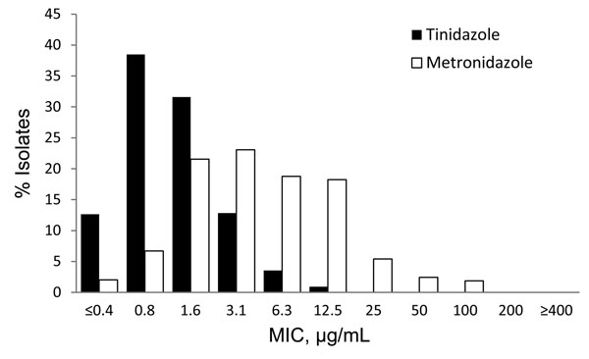
Figure
Figure. . . Distribution of minimum lethal concentrations (MLCs) of tinidazole and metronidazole, STD Surveillance Network, 2009–2010 (n = 538). Susceptibility to metronidazole and tinidazole are defined as MLC &lt;25 μg/mL, low-level resistance as MLC 50–100 μg/mL, moderate-level resistance as MLC 200 μg/mL, and high-level resistance as MLC &gt;400 μg/mL.
Kirkcaldy RD, Augostini P, Asbel LE, Bernstein KT, Kerani RP, Mettenbrink CJ, et al. Trichomonas vaginalis Antimicrobial Drug Resistance in 6 US Cities, STD Surveillance Network, 2009–2010. Emerg Infect Dis. 2012;18(6):939-943. https://doi.org/10.3201/eid1806.111590

