Slide 1
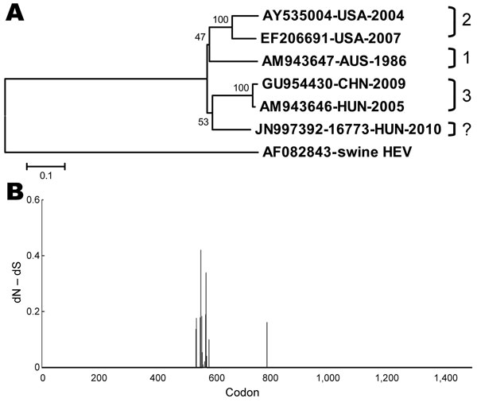
Figure
Figure. . . . Genomic structure of HUN-16773-2010 and 5 other avian hepatitis E virus (aHEV) strains. A) Neighbor-joining tree constructed from the nucleotide sequences (14) of the nearly complete genome of 6 aHEV strains. Bootstrap values are indicated at branch nodes. A swine HEV served as outgroup in the phylogeny. Genotype assignments are depicted for reference aHEV genomes. Scale bar indicates genetic distance. B) Adaptive evolution of aHEV genomes. Only sites under positive selection in open reading frame 1 are shown with normalized value of dN – dS along the codon positions, as indicated by the random effects likelihood method and by using the default significance level (www.datamonkey.org).
Bányai K, Tóth Á, Ivanics É, Glávits R, Szentpáli-Gavallér K, Dán Á. Putative Novel Genotype of Avian Hepatitis E Virus, Hungary, 2010. Emerg Infect Dis. 2012;18(8):1365-1368. https://doi.org/10.3201/eid1808.111669

